Slide 1





FRAUD DETECTION ANALYSIS
Eugenia, Maia, Punit, Troy

Slide 2

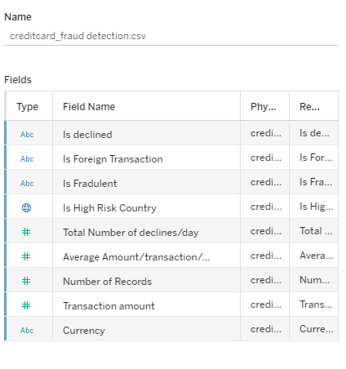
About the creditcard_fraud Dataset

Slide 3
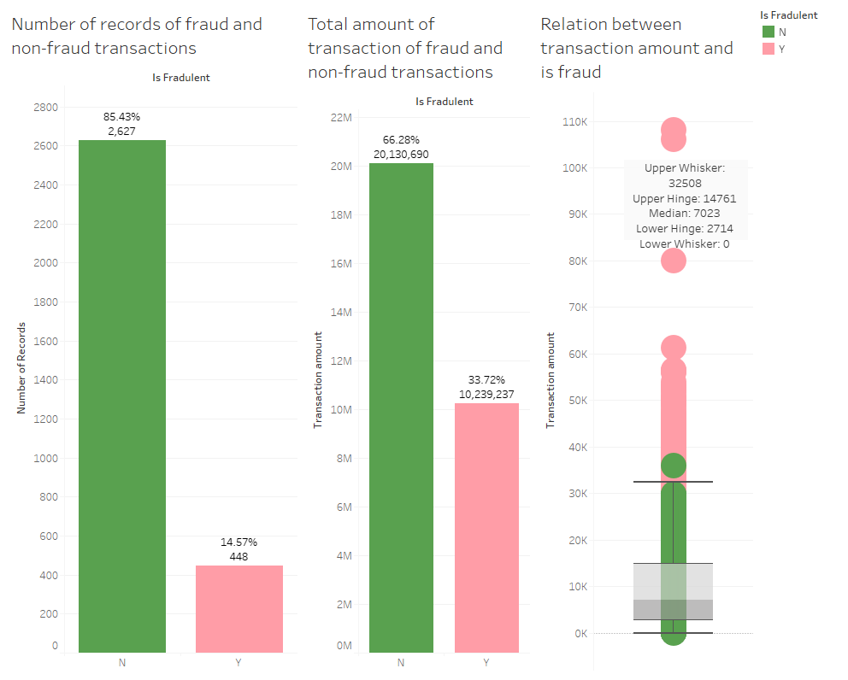

The total number of transactions is 3,075
the total amount of all the transactions is 30,369,927

Slide 4

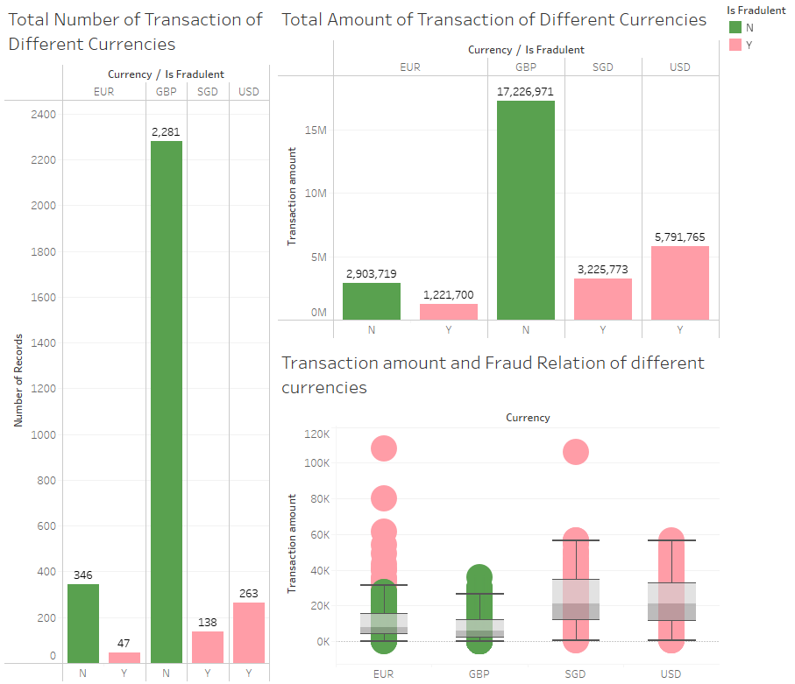


is there a Relationship
between
currency type
and fraud
transactions?
YES!

Slide 5
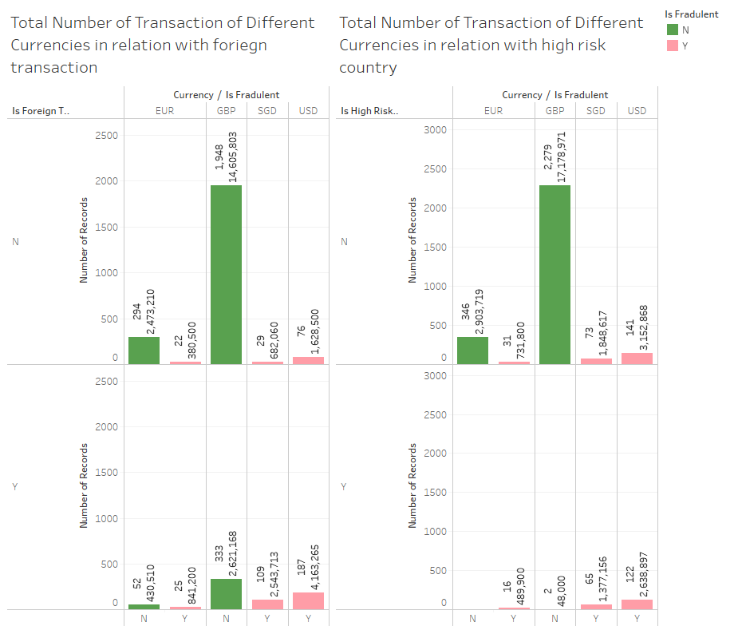
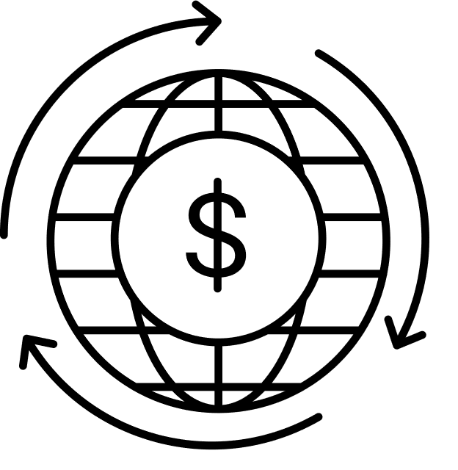
Total transactions categorized by currency involving foreign transactions and high-risk countries.

Slide 6


SAFETY NET OVERVIEW
WHAT IS A SAFETY NET?
SIGNIFICANCE OF SAFETY NET

Slide 7
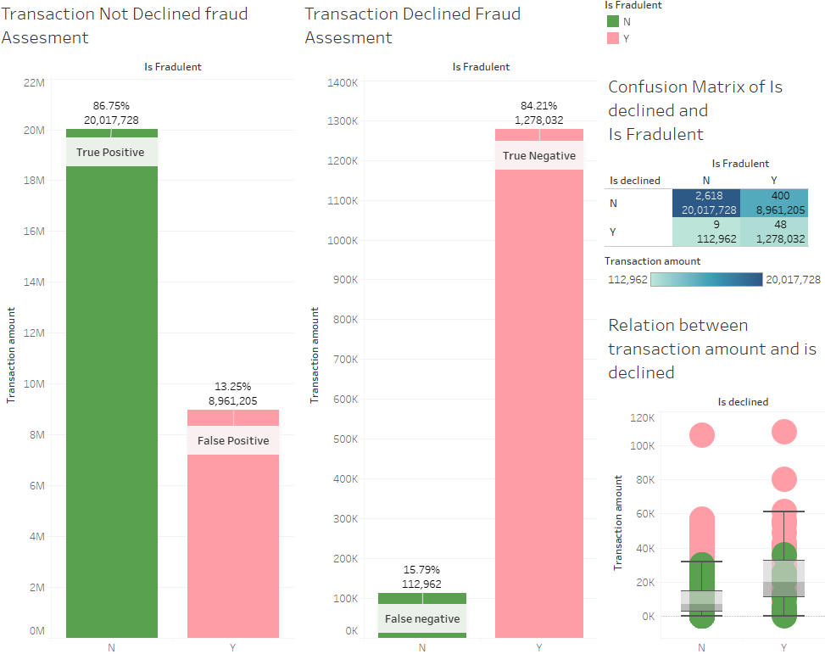

SAFETY NET ANALYSIS

Slide 8

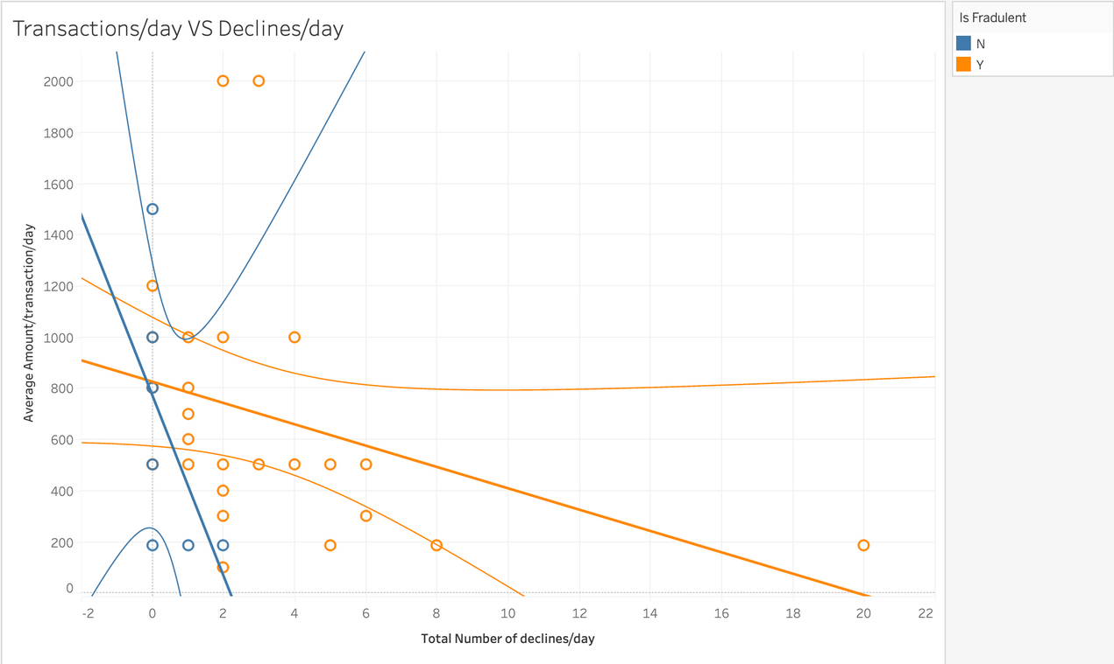
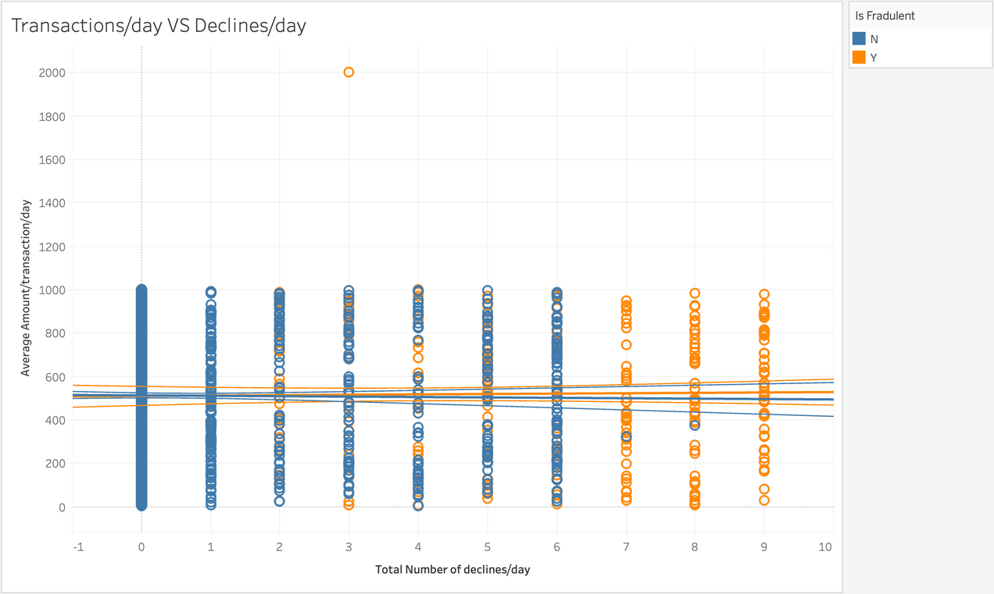
is the safety net working?
Declined: Yes --> Negative relation
Declined: No --> No relation
Potential reasons:
Partial Effectiveness
False Positives
Potential reasons:
Time Trends
Transaction Amount
conclusion: seems to for small frauds

Slide 9

Questions and Answers

